Slide 1
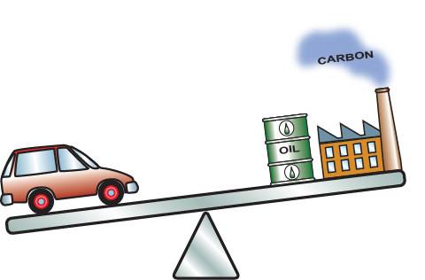
Unité 12.
L’Eco-sélection: l’outil Eco-audit
Introduire aux étudiants une réflexion sur le cycle de fin de vie des produits
Notes:
There are notes here for all of the slides
The 23 Lecture Units For 2011
Topic Number Name
Finding and Displaying Information
Unit 1 The materials and processes universe: families, classes, members, attributes
Unit 2 Materials charts: mapping the materials universe
Material Properties
Unit 3 The Elements: Property origins, trends and relationships
Unit 4 Manipulating Properties: Chemistry, Microstructure, Architecture
Unit 5 Designing New Materials: Filling the boundaries of materials property space
Selection
Unit 6 Translation, Screening, Documentation: the first step in optimized selection
Unit 7 Ranking: refining the choice
Unit 8 Objectives in conflict: trade-off methods and penalty functions
Unit 9 Material and shape
Unit 10 Selecting processes: shaping, joining and surface treatment
Unit 11 The economics: cost modelling for selection
Sustainability
Unit 12 Eco Selection: the eco audit tool
Unit 13 Advanced Eco design: systematic material selection
Unit 14 Low Carbon Power: Resource Intensities and Materials Use
Special Topics
Unit 15 Architecture and the Built Environment: materials for construction
Unit 16 Structural sections: shape in action
Unit 17 CES EduPack Bio Edition: Natural and man-made implantable materials
Unit 18 Materials in Industrial design: Why do consumers buy products?
Advanced Teaching and Research
Unit 19 Advanced Databases: Level 3 Standard, Aerospace and Polymer
Unit 20 Hybrid Synthesizer: Modelling Composites, Cellular structures and Sandwich panels
Unit 21 Database creation: Using CES Constructor in Research
Unit 22 Research: CES Selector and Constructor
Unit 23 Campus: Overview of this commercial polymers database

Slide 2
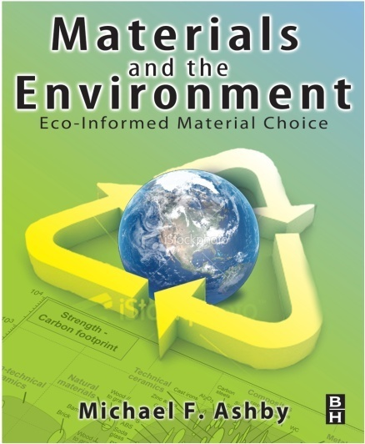
Sommaire
Consommation de matériaux et cycle de vie
ACV – problèmes et solutions
Eco-audits et l’outil d’audit
Stratégie pour la sélection de matériaux
Démo
Exercices
Ressources
  Livre: “Materials and the Environment”, Chapitres 1 - 9
  Livre: “Materials: engineering, science, processing and design”, 2ème Edition, Chapitre 20
  Livre: “Materials Selection in Mechanical Design”, 4ème Edition, Chapitre 16
  Logiciel: CES EduPack avec l’outil Eco-Audit
  Poster: Graphiques des Eco-propriétés des matériaux
Notes:
Motivation
We use materials and energy on a colossal scale (see next 2 overheads)
Making materials accounts for about 30% of all energy consumption – most derived from fossil fuels
Dependence on imported fossil fuel caries economic and security risks
Continued release of carbon to atmosphere carries risk
We have a responsibility to seek to minimize energy / carbon aspects of material usage.
The 2011 release of the Edu Eco-audit tool
The eco-audit tool has been upgraded for 2011. This set of PowerPoint frames is an introduction to its features and use and how it can be used to introduce students to life-cycle thinking.

Slide 3
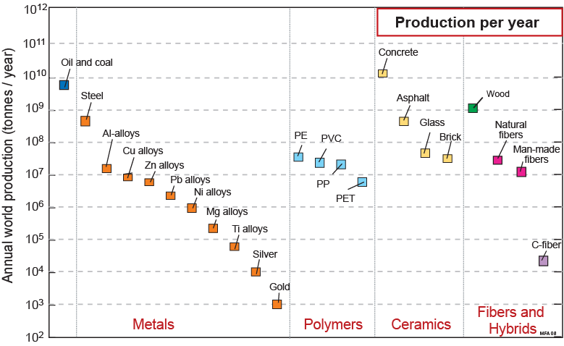
Production annuelle de matériaux
Préoccupation 1: Consommation des ressources, dépendance
Production mondiale annuelle (tonnes/an)
Production par an
96% de
l’utilisation
de matériaux
=
20% de
l’énergie
globale
Notes:
Speaking globally, we consume roughly 10 billion (10¹⁰) tonnes of engineering materials per year. This bar-chart shows the annual world production of the materials that are used in the greatest quantities. On the extreme left, for calibration, are hydrocarbon fuels – oil and coal – of which we currently consume about 9 billion tonnes per year. Next, moving to the right, are metals. The scale is logarithmic, making it appear that the consumption of steel (the first metal) is only a little greater than that of aluminum (the next); in reality, the consumption of steel exceeds, by a factor of ten, that of all other metals combined. Polymers come next: today the combined consumption of commodity polymers polyethylene (PE), polyvinyl chloride (PVC), polypropylene (PP) and polyethylene-terephthalate, (PET) begins to approach that of steel.
The really big ones, though, are the materials of the construction industry. Steel is one of these, but the consumption of wood for construction purposes exceeds that of steel even when measured in tonnes per year (as in the diagram), and since it is a factor of 10 lighter, if measured in m³/year, wood totally eclipses steel. Bigger still is the consumption of concrete, which exceeds that of all other materials combined. The other big ones are asphalt (roads) and glass.
The remaining columns show the production of natural and artifical fibers, ending with carbon fiber. Just 20 years ago this material would not have crept onto the bottom of this chart. Today its consumption is approaching that of titanium and is growing fast.
The columns on this figure describe broad classes of materials, so – out of the many thousands of materials now available – they probably include 99.9% of all consumption when measured in tonnes. This is important when we come to consider the impact of materials on the environment, since impact scales with consumption.

Slide 4
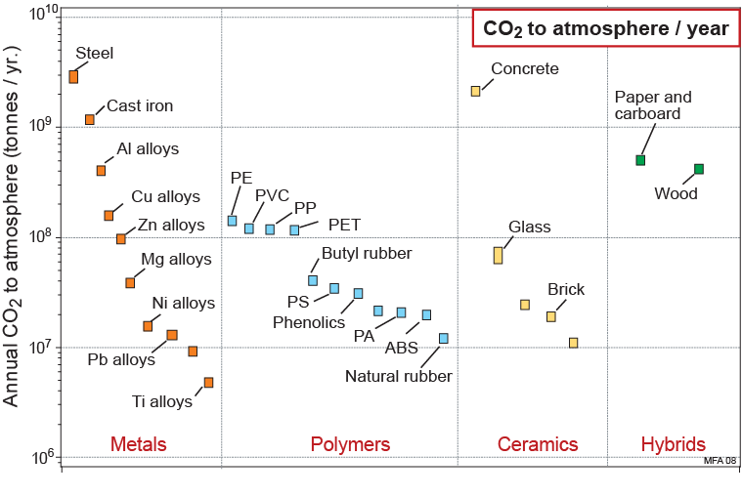
Rejet de Carbone dans l’atmosphère
Préoccupation 2: Consommation d’énergie, Emission de CO₂
Rejet CO₂ atmosphère / an
Rejet annuel de CO₂ (tonnes/an)
20% de tous
les rejets
dans
l’atmosphère
Notes:
Carbon release to atmosphere caused by the production of materials is calculated by multiplying the annual production (last frame) by the embodied energy of the material (defined and plotted in later frames). This is what it looks like. The order changes a little from that of the last frame, but not much. If you want a BIG change in the contribution of material production to the carbon problem, it is these materials on which attention must focus.

Slide 5
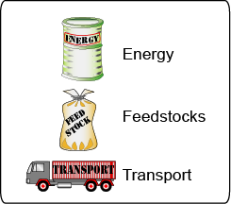

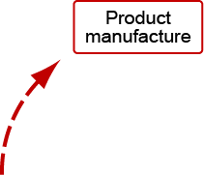
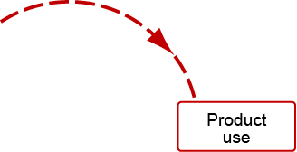

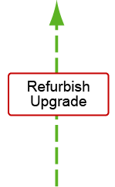
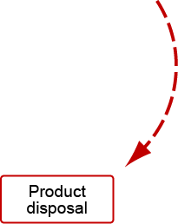

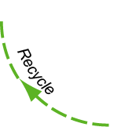

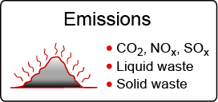

Le Cycle de Vie du produit
Ressources
Energie
Analyse du Cycle
de Vie (ACV)
Matière
premières
Transport
Fabrication
Production
Ressources naturelle
Production
de matière
Rénovation
Amélioration
Utilisation du
produit
Elimination
du produit
Emissions et déchets
Incinération
Enfouissement
des déchets
CO₂ , NO_{x} , SO_{x}
Déchets liquides
Déchets solides
Notes:
5
This frame shows the materials lifecycle. Ore and feedstock, drawn from the earth’s resources, are processed to give materials. These are manufactured into products that are used, and, at the end of their lives, discarded, a fraction perhaps entering a recycling loop, the rest committed to incineration or land-fill. Energy and materials are consumed at each point in this cycle (we shall call them “phases”), with an associated penalty of CO₂ , SO_{x}, NO_{x} and other emissions – heat, and gaseous, liquid and solid waste, collectively called environmental “stressors”. These are assessed by the technique of life-cycle analysis (LCA).
ISO 14000 and PAS 2050 of the International Standards Organization defines a family of standards for environmental management systems. ISO 14000 contains the set IS0 14040, 14041, 14042 and 14043 published between 1997 and 2000, prescribing broad procedures for conducting the four steps of an LCA: setting goals and scope, inventory compilation, impact assessment and interpretation. The standard is an attempt to bring uniform practice and objectivity into life-cycle assessment and its interpretation, but implementation is cumbersome and expensive.
PAS 2050 (2008) is a more recent set of draft standards for the carbon assessment of products.

Slide 6
Analyse du Cycle de Vie (ACV)
Séries ISO 14040
PAS 2050
Résultat typique d’une ACV
Canette d’Aluminium, 1000 unités
Bauxite 59 kg
Pétrole 148 MJ
Electricité 1572 MJ
Energie en matière première 512 MJ
Utilisation d’eau 1149 kg
Emissions: CO₂ 211 kg
Emissions: CO 0.2 kg
Emissions: NO_{x} 1.1 kg
Emissions: SO_{x} 1.8 kg
Particules 2.47 kg
Potentiel de réduction
de la couche d’ozone 0.2 X 10⁻⁹
Potentiel de réchauffement
climatique 1.1 X 10⁻⁹
Potentiel d’acidification 0.8 X 10⁻⁹
Potentiel de toxicité pour l’homme 0.3 X 10⁻⁹
Consommation
de ressources
Inventaires des
émissions
Regrouper autour
d’un “éco-indicateur” ?
Estimation des
impactes
Une ACV complète coûte cher , requière beaucoup de détail et de compétences – même avec tout cela reste, elle reste sujette à l’incertitude.
Comment un designer peut-il utiliser ces données ?
Notes:
6
The upper part of this frame lists the typical ouput of an LCA that meets the ISO 14040 guidelines. A full LCA is time-consuming, expensive and it cannot cope with the problem that 80% of the environmental burden of a product is determined in the early stages of design when many decisions are still fluid.
There is a second problem: what is a designer supposed to do with this information? How are C0₂ and S0_{x} productions to be balanced against resource depletion, toxicity or ease of recycling when choosing a material? This question has lead to efforts to condense the eco-information about a material into a single measure or eco-indicator, giving the designer a simple, numeric ranking. The use of a single-valued indicator is criticised by some. The grounds for criticism are that there is no agreement on normalisation or weighting factors used to calculate them and that the method is opaque since the indicator value has no simple physical significance.

Slide 7
Orientation de Conception & Evaluation du Produit
Besoins du marché
Enoncé du Problème
Projets alternatifs
Agencement et
Matériaux
CAO, Méthode des éléments
finis, optimisation,
coûts de production
Concept
Mode de
création
Compétence
Eco – audit
Particularités
Spécification du produit
Analyse du Cycle
de Vie (ACV)
Production
Notes:
Design starts with the identification of a market need. Concepts (general working principles) are identified to fill the need. The most promising of these are developed into sketches or diagrams indicating configuration, lay-out and scale (“embodiment”). One or more of these is selected for detailed development, analyzing performance, safety and cost. The output is a design enabling the construction of a prototype that, after testing and development, goes to manufacture.
Material information enters all stages of the design. At the concept stage the design is fluid and all materials are candidates. Here the need is the ability to scan the entire Materials Universe, but at a low resolution. As the design gels and the requirements become sharper, the need becomes that for information about fewer materials but at a higher level of precision. In the final, detailed, stage when finite element, optimization and other analyses are undertaken, the need is for data for just one or a very few materials at the highest precision. The screening process narrows the initially wide material search space containing all materials (triangle on the right) ultimately leading to a final single choice.

Slide 8
Eco-audit pour la conception
Besoin: Un Eco-audit rapide et suffisamment précis pour aider à la prise de décision.
Ressource – énergie
Emission – L’équivalent CO₂
Distinguer les phases de vie du produit
600
400
300
200
100
0
-100
16
14
12
10
8
6
4
2
0
-2
Matériaux
Utilisation
Matériaux
Utilisation
Fabrication
Equivalent C0₂ (kg)
Energie (MJ)
Fabrication
Transport
Transport
Elimination
Elimination
Crédit FdV
Elimination
Crédit FdV
Ces graphiques présentent l’énergie et le CO₂ consommé durant la vie du produit.
(Comme prescrit dans l’ISO 14040 & la PAS 2050)
Ces parties représentent les bénéfices potentiels en fin de vie du produit.
(Ce qui peut être potentiellement récupérable)
Notes:
8
The strategy for guiding design has 3 steps, detailed here and on the next two frames.
The first step is one of simplification, developing a tool that is approximate but retains sufficient discrimination to differentiate between alternative choices. A spectrum of levels of analysis exist, ranging from a simple eco-screening against a list of banned or undesirable materials and processes to a full LCA, with overheads of time and cost. In between lie methods that are less rigorous; they are approximate but fast.
The second step is to select a single measure of eco-stress. On one point there is some international agreement: the Kyoto Protocol of 1997 committed the developed nations that signed it to progressively reduce carbon emissions, meaning CO₂. At the national level the focus is more on reducing energy consumption, but since this and CO₂ production are closely related, they are nearly equivalent. Thus there is a certain logic in basing design decisions on energy consumption or CO₂ generation; they carry more conviction than the use of a more obscure indicator. We shall follow this route, using energy as our measure.
The third step is to separate the contributions of the phases of life because subsequent action depends on which is the dominant one. If it is that a material production, then choosing a material with low “embodied energy” (defined on a later frame) is the way forward. But if it is the use phase, then choosing a material to make use less energy-intensive is the is the right approach – even if it has a higher embodied energy.

Slide 9
L’Eco-conscience pour la conception:
La stratégie (1)
Les étapes
Analyse des
résultats,
Identification
des priorité
Exploration des nouvelles options
Eco-audit
rapide
Et si ...
Différent matériaux?
Utilisation
Conception initiale
600
400
300
200
100
0
-100
600
400
300
200
100
0
-100
Matériaux
Utilisation
Matériaux
Energie (MJ)
Fabrication
Energie (MJ)
Fabrication
Transport
Transport
Elimination
Crédit FdV
Elimination
Crédit FdV
Notes:
This frame illustrates the second step.
An initial eco-audit of the product reveals the energy requirements and carbon emissions, identifying the phases of life that create the greatest burden. The tool then allows rapid “what if ….?” exploration of alternative materials, transport mode, use pattern and end-of-life choices, revealing the consequences of a change in any one of these on the others.

Slide 10
Eco-aware design: the strategy (2)
Les étapes
Analyse des
résultats,
Identification
des priorité
Exploration des nouvelles options
Sélection de
nouveaux matériaux
et/ou de nouveaux
procédés avec CES
Recommender de nouvelles actionet évaluer les gains potentiels
Eco-audit
rapide
600
400
300
200
100
0
-100
Utilisation
Utiliser l’éco-audit
pour identifier les
objectifs de conception
Matériaux
Energie (MJ)
Fabrication
Transport
Elimination
Crédit FdV
Matériaux
Fabrication
Transport
Utilisation
Fin de vie
Minimiser:
les matériaux
l’énergie grise
CO2 / kg
Minimiser:
l’énergie de
fabrication
CO2/kg
Minimiser:
poid
distance
modes de
transport
Minimiser:
poid
pertes thermiques et électriaques
Selectionner:
matériaux non-toxic
matériaux recyclables
Notes:
The third step is a more systematic analysis of materials selection, targeting the most energy and carbon-intensive phases of life. The eco-audit identifies the design objective that is a key input for the established materials selection methodology that is built into the CES EduPack software.

Slide 11
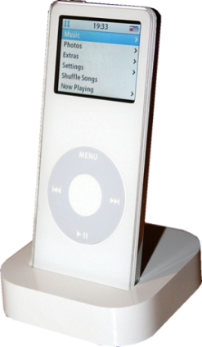
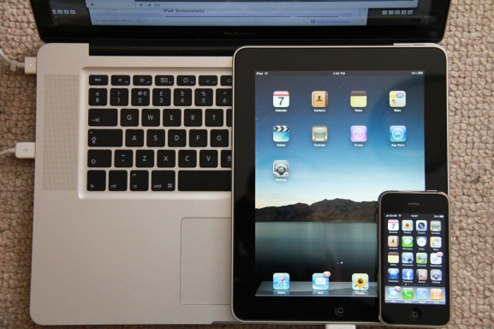
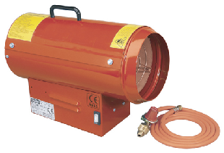
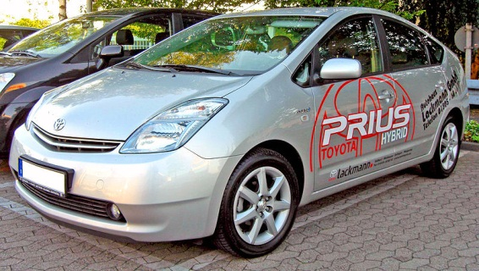
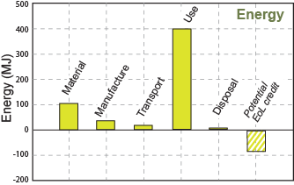
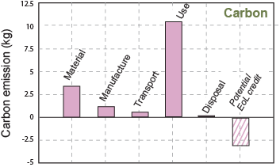
L’outil Eco-audit du CES EduPack
Données Utilisateur
Données du CES
Interface Utilisateur
Coût des matériaux
Procédés de fabrication
Transport
Utilisation
Choix de fin de vie
Base de donnée Eco
Energie Grise
Energie de Fabrication
Empreintes CO₂
Energie de Transport
Recyclage / combustion
Modèle
Eco audit
Utilisation
Résultats
(Incluant les données tabulaires)
Utilisation
Matériaux
Matériaux
Energie (MJ)
Fabrication
Elimination
Emission de Carbone (kg)
Fabrication
Transport
Crédit FdV
Transport
Elimination
Crédit FdV
Notes:
11
This frame shows how the eco-audit of a product works. The inputs are of two types. The first are drawn from a user-entered bill of materials, process choice, transport requirements, duty cycle (the details of the energy and intensity of use) and disposal route, shown at the top left.
Data for embodied energies, process energies, recycle energies and carbon intensities are drawn from a database of material properties; those for the energy and carbon intensity of transport and the use-energy are drawn from the CES EduPack database of eco-attributes of materials. The outputs are the energy or carbon footprint of each phase of life, presented as bar charts and in tabular form.
The next 4 frames illustrate the use of the Eco-audit too.

Slide 12
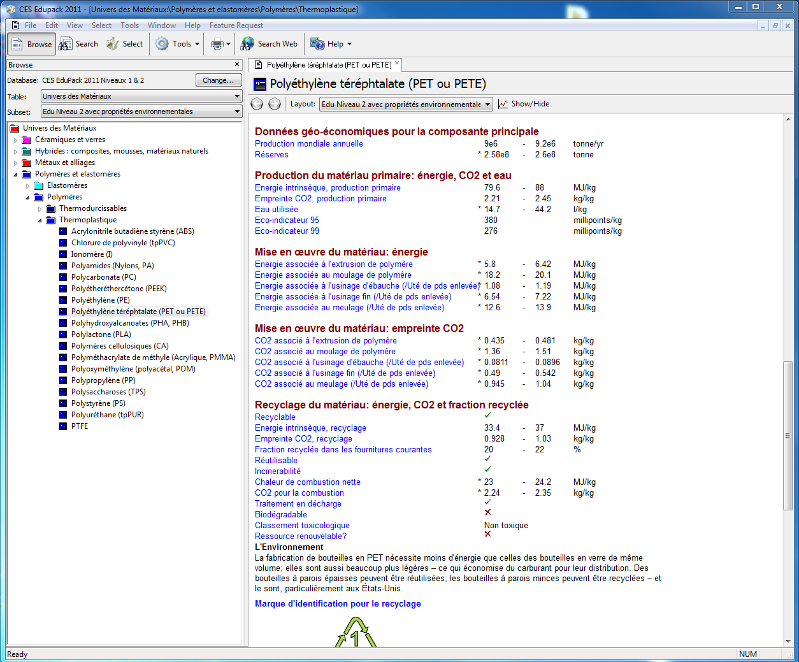
Fiche montrant des éco-propriétés
Notes:
This frame shows the eco-data contained in the records in the CES EduPack software. Each record contains
Geo-economic data – annual world production, reserves, etc
Embodied energy and carbon footprint for the material
Processing energy and carbon emissions for manufacturing processes
Environmental data pertinent to the end-of-life
In addition there are tables of data for electronics, for transport, and for energy.

Slide 13


L’outil éco-audit: Niveaux 1, 2 et 3
Add record
Eco Audit
Synthesizer
Options….
?
^ 1. Material, manufacture and end of life
1 Component 1 Cast iron 30% 2.4 Casting Recycle
1 Component 2 Polypropylene 0% 0.35 Molding Landfill
Quantité?
Nom
Choix de matériaux dans la base de données du CES
Fixer le contenu recyclé
0 – 100%
Entrer la masse
Choix du mode de fin de vie
?
Sélectionner le procédé
v 2. Transport
AIDE pour chacune des étapes
?
v 3. Use
?
v 4. Report
Notes:
13
This frame introduces the simple CES EduPack Eco-audit Tool.
The tool is opened from the Tools menu at the top of the CES EduPack screen. Its use involves four steps, listed as 1 to 4 in the frame.
1. Each component is assigned a material (chosen from one of the CES EduPack databases), a recycle content, a mass, a primary manufacturing process and an end of life choice.
Transport mode and distances are entered.
Use is treated by entering the duty cycle (the energy demands of use).
Clicking on “Report” then generates the bar charts of energy and carbon, and tables listing a break-down by component.
The following frames show the four steps in more detail. They use a simplified schematic of the interface shown above.

Slide 14
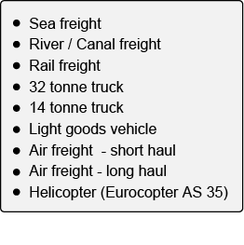
Transport
Phase de Transport
transport type Distance (km)
Phase 1
32 tonne truck
350
Phase 2 Sea freight 12000
Transport énergie
Transport CO₂
Table des types de transports: MJ / tonne.km
CO₂ / tonne.km
Utilisation
Matériaux
Energie (MJ)
Fabrication
Transport
Elimination
Crédit FdV
Notes:
14
This step estimates the energy for transportation of the product from manufacturing site to point of sale. The energy demands of chosen transport in 0.9 MJ/tonne.km, retrieved from a look-up table in CES EduPack, is multiplied by the mass of the product and the distance travelled to give the travel energy. Carbon footprint is calculated in a similar way.

Slide 15
Matériaux et Energies de fabrication / CO₂
Nom du
Composant Matériaux Procédé Masse (kg) Fin de Vie
Composant 1
Alliages d’Aluminium
Moulage
2.3
Recycle
Composant 2 Polypropylène Moulage de polymère 1.85 Landfill
Composant 3 Verre Moulage de verre 3.7 Reuse
Energie Grise totale
Energie totale de
Fabrication
Masse totale
Energie totale de
fin de vie
Utilisation
Matériaux
Energie (MJ)
Fabrication
Transport
Elimination
Crédit FdV
Notes:
Materials, processes and end-of-life choice are entered in the way shown here. A bill of materials is drawn up, listing the mass of each component used in the product and the material of which it is made, as on the left. Data for the embodied energy (MJ/kg) and CO2 (kg/kg) per unit mass for each material is retrieved from the database – here, the data sheets of Part 2 of this book, using the means of the ranges listed there (right hand side of the Table). Multiplying the mass of each component by its embodied energy and summing gives the total material energy – the first bar of the bar-chart.
The audit focuses on primary shaping processes since they are generally the most energy-intensive steps of manufacture. These are listed against each material, shown here. The process energies and CO₂ per unit mass are retrieved from the database. Multiplying the mass of each component by its primary shaping energy and summing gives an estimate of the total processing energy – the second bar of the bar-chart.
On a first appraisal of the product it is frequently sufficient to enter data for the components with the greatest mass, accounting for perhaps 95% of the total. The residue is included by adding an entry for “residual components” giving it the mass required to bring the total to 100% and selecting a proxy material and process: “polycarbonate” and “molding” are good choices because their energies and CO₂ lie in the mid range of those for commodity materialss.
Finally, the end-of-life choice is selected from the list of 5 options, listed here..

Slide 16
Utilisation du mode statique (static mode)
Energie en entré et
en sortie
Energie fossile fuel -> Elec.
Evaluation de la
puissance
1.2
kW
Energy conversion path
Fossil fuel to heat, enclosed system
Fossil fuel to heat, vented system
Fossil fuel to electric
Fossil fuel to mechanical
Electric to heat
Electric to mechanical (electric motor)
Electric to chemical (lead-acid battery)
Electric to chemical (Lithium-ion battery)
Electric to light (incandescent lamp
Electric to light (LED)
Utilisation
365
W
kW
MW
hp
ft.lb/sec
kCal/yr
BTU/yr
days per year
Utilisation
0.5
hours per day
Energie et CO₂ total pour l’utilisation
Utilisation
Energie
Energie (MJ)
Matériaux
Fabrication
Transport
Elimination
Crédit FdV
Notes:
16
The use phase requires a little explanation. There are two different classes of contribution.
Most products require energy to perform their function: electrically powered products like hairdryers, electric kettles, refrigerators, power tools and space heaters are examples. Even apparently non-powered products like household furnishings or unheated buildings still consume some energy in cleaning, lighting and maintenance. The first class of contribution, then, relates to the power consumed by, or on behalf of, the product itself.
The second class is associated with transport. Products that form part of a transport system or are carried around in one add to its mass and thereby augment its energy consumption and CO2 burden. This carries an energy and CO₂ penalty per unit weight and distance. Multiplying this by the product weight and the distance over which it is carried gives an estimate of the associated use-phase energy and CO₂.
All energies are related back to primary energy, meaning oil, via oil-equivalent factors for energy conversion. Retrieving these and multiplying by the power and the duty cycle – the usage over the product life – gives an estimate of the oil-equivalent energy of use.

Slide 17
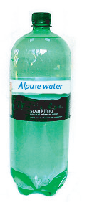
Bouteille d’eau (100 unités)
Bouteille de 1 litre en PET
Bouchon en PP
Moulage par soufflage
Remplie en France, transporté par camion 550 km
Refrigéré 2 jours avant d’être bu
Number Name Material Process Mass (kg) End of life
100 Bouteille PET Moulage 0.04 Recycle
100 Capsule Polyprop Moulage 0.001 Recycle
100 Eau 1.0
Transport
France -> UK
14 tonne truck
550 km
Use - refrigeration
Fossile -> Elec.
0.12 kW
2 jours
24 h/jour
Notes:
17
Here is an extremely simple example to illustrate how the Eco-audit tool works. One brand of bottled water – we will call it Alpure – is sold in 1-liter PET bottles with polypropylene caps. One bottle weighs 40 grams; its cap weighs 1 gram. The bottles and caps are molded, filled with water in the French Alps and transported 550 km to London, England, by 14 tonne truck. Once there they are refrigerated for 2 days, on average before consumption. We use these data for the case study, taking 100 bottles as the unit of study, requiring 1 m³ of refrigerated space.
At end of life the bottles are recycled.

Slide 18

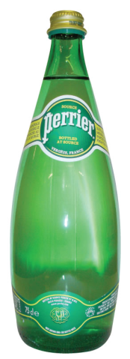
Le résultat: Récipient pour boisson
400
300
200
100
0
-100
-200
L’audit révèle les étapes consommant le plus d’énergie et de carbone…
Energie (MJ)
… et permet ensuite de voir rapidement “Que se passerait il si… ?”
Energy (MJ)
Fin de vie
Matériaux Fabrication Transport Utilisation
PET 100% brut
avec recyclage en fin de vie
12
10
8
6
4
2
0
-2
-4
-6
Emission de Carbone (kg)
Carbon (kg)
End of life
Fin de vie
Matériaux Fabrication Transport Utilisation
Material Manufacture Transport Use
PET Verre ?
PET 100% brut
avec recyclage en fin de vie
Notes:
Here is the output of the eco-audit tool for the PET bottle plus water, using the data shown on the previous 3 frames. The embodied energy of the PET is the largest contributor to energy demand and carbon release.
Would it be lower if the bottle were made of glass instead? The next two frames explore this “what if …?”.

Slide 19
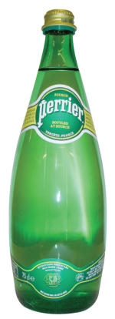
Changement de matériaux
Bouteille de 1 litre en verre
Bouchon en aluminium
Verre moulé
Remplie en France, transporté par camion 550 km
Réfrigérée 2 jours avant d’être bu
Number Name Material Process Mass (kg) End of life
100 Bottles PET Molding 0.04 Recycle
Verre
Verre moulé
0.45
0.002
100 Caps Polyprop Molding 0.0001 Recycle
Aluminium
Laminage
100 Water 1.0
Transport
France -> UK
14 tonne truck
550 km
Use - refrigeration
Fossile -> Elec.
0.12 kW
2 jours
24 h/jour
Notes:
19
This frame shows a change of material. Here is the material of the bottle has been changed to glass, entering the mass of a typical 1 liter glass wine bottle (0.45 kg). The material of the cap has been changed to aluminum, again using a typical mass for one cap.

Slide 20


Remplacement du PET par du verre
400
300
200
100
0
-100
-200
Changement d’échelle
800
600
400
200
0
-200
-400
Energie (MJ)
Energie (MJ)
Energy (MJ)
Energy (MJ)
Fin de vie
Fin de vie
End of life
End of life
Material Manufacture Transport Use
Material Manufacture Transport Use
Matériaux Fabrication Transport Utilisation
Matériaux Fabrication Transport Utilisation
PET 100% brut
avec recyclage en fin de vie
Verre 100% brut
avec recyclage en fin de vie
12
10
8
6
4
2
0
-2
-4
-6
Changement d’échelle
60
50
40
30
20
10
0
-10
-20
-30
Carbon (kg)
Carbon (kg)
Emission de Carbone (kg)
Emission de Carbone (kg)
Fin de vie
End of life
End of life
Fin de vie
Matériaux Fabrication Transport Utilisation
Matériaux Fabrication Transport Utilisation
Material Manufacture Transport Use
Material Manufacture Transport Use
PET 100% brut
avec recyclage en fin de vie
Verre 100% brut
avec recyclage en fin de vie
Notes:
The original output of the eco-audit tool for the PET bottle plus water is shown on the left. The output for the glass bottle appears on the right. Note the change of scale. The glass bottle requires almost twice as much energy and emits twice as much carbon and the PET bottle, largely because of its much greater mass.

Slide 21

Utilisation de PET recyclé au lieu du brut?
400
300
200
100
0
-100
-200
400
300
200
100
0
-100
-200
Energy (MJ)
Energy (MJ)
Fin de vie
End of life
Material Manufacture Transport Use
End of life
Material Manufacture Transport Use
Matériaux Fabrication Transport Utilisation
Fin de vie
Matériaux Fabrication Transport Utilisation
PET 100% brut
avec recyclage en fin de vie
PET 100% recyclé
avec recyclage en fin de vie
12
10
8
6
4
2
0
-2
-4
-6
12
10
8
6
4
2
0
-2
-4
-6
Carbon (kg)
Carbon (kg)
Fin de vie
End of life
Matériaux Fabrication Transport Utilisation
Fin de vie
Matériaux Fabrication Transport Utilisation
Material Manufacture Transport Use
End of life
Material Manufacture Transport Use
PET 100% brut
avec recyclage en fin de vie
PET 100% recyclé
avec recyclage en fin de vie
Notes:
This frame shows the consequences of using recycled instead of virgin PET. (Original eco-audit on the left, modified audit on the right). The material energy and carbon decrease significantly. The end of life credit, however, is lower.

Slide 22
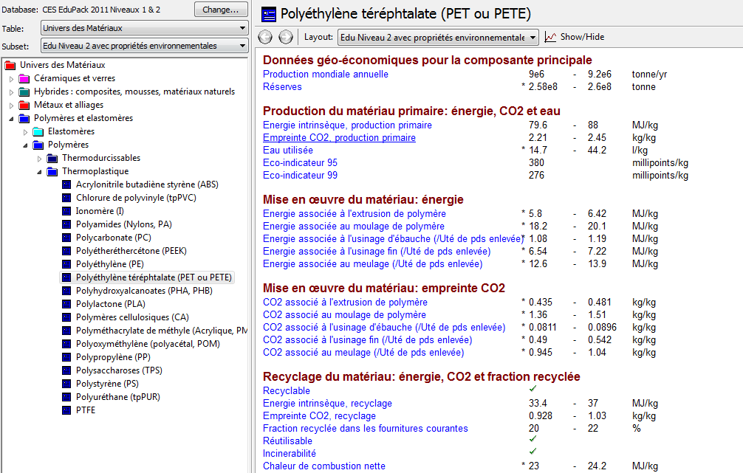
Est-il pragmatique d’utiliser du PET recyclé?
Notes:
Is recycled PET a realistic choice? Opening the record for PET shows that roughly 20% of current PET supply derives from recycling, so its use is a realistic possibility.

Slide 23

Incinérer au lieu de recycler
400
300
200
100
0
-100
-200
400
300
200
100
0
-100
-200
Energie (MJ)
Energie (MJ)
Energy (MJ)
Energy (MJ)
Fin de vie
Fin de vie
End of life
End of life
Material Manufacture Transport Use
Material Manufacture Transport Use
Matériaux Fabrication Transport Utilisation
Matériaux Fabrication Transport Utilisation
PET 100% brut
avec recyclage en fin de vie
PET 100% brut
avec incinération en fin de vie
12
10
8
6
4
2
0
-2
-4
-6
12
10
8
6
4
2
0
-2
-4
-6
Carbon (kg)
Carbon (kg)
Emission de Carbone (kg)
Emission de Carbone (kg)
Fin de vie
End of life
Matériaux Fabrication Transport Utilisation
Fin de vie
Matériaux Fabrication Transport Utilisation
Material Manufacture Transport Use
End of life
Material Manufacture Transport Use
PET 100% brut
avec recyclage en fin de vie
PET 100% brut
avec incinération en fin de vie
Notes:
This frame shows the consequences of choosing combustion with energy recovery rather than recycling at end-of-life. (Original eco-audit on the left, modified audit on the right). There is a small energy-credit at end of life, but the combustion creates a large carbon emission.

Slide 24
Transport par fret aérien, réfrigérer 10 jours
400
300
200
100
0
-100
-200
Changement d’échelle
1000
800
600
400
200
0
-200
-400
Energie (MJ)
Energie (MJ)
Energy (MJ)
Energy (MJ)
Fin de vie
Disposal
Fin de vie
Fin de vie
Material Manufacture Transport Use
Disposal
Matériaux Fabrication Transport Utilisation
Matériaux Fabrication Transport Utilisation
PET 100% brut
avec transport par poids lourd
PET 100% brut
avec transport par fret aérien
12
10
8
6
4
2
0
-2
-4
-6
Changement d’échelle
60
50
40
30
20
10
0
-10
-20
-30
Carbon (kg)
Carbon (kg)
Emission de Carbone (kg)
Emission de Carbone (kg)
Fin de vie
Fin de vie
Disposal
Matériaux Fabrication Transport Utilisation
Matériaux Fabrication Transport Utilisation
Material Manufacture Transport Use
PET 100% brut
avec transport par poids lourd
PET 100% brut
avec transport par fret aérien
Notes:
This frame shows a further “what if …?” Here the consequences of choosing air freight rather than 14 tonne truck as the transport mode for the filled bottles, and that of refrigerating the bottle for 10 days instead of 2. (Original eco-audit on the left, modified audit on the right – note the change of scale). The transport energy now dominates the energy and emissions, and the use phase has increased until it is comparable with that of the material.

Slide 25
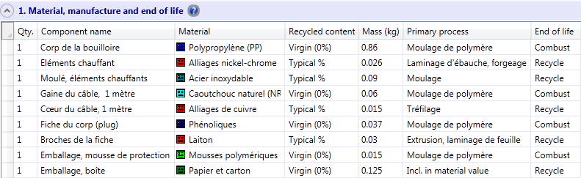
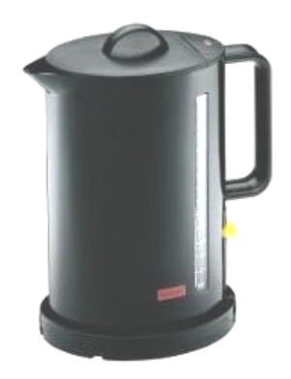
Bouilloire
Matériaux et procédés utilisés
Bouilloire 2 kW
Fabriquée en Asie
Transportée en avion en
Angleterre
Durée de vie: 3 ans
Transport
Utilisation
12,000 km, transport en avion
250 km en camion 14 tonnes
6 minutes par jours
300 days par an
3 ans
Notes:
25
Here is a second example: a 2 kW electric jug-kettle. The kettle is manufactured in South-east Asia and transported to Europe by air freight, a distance of 12,000 km. The table lists the bill of materials. The kettle boils 1 liter of water in 3 minutes. It is used to do this, on average, twice per day 300 days per year over a life of 3 years. At end of life metal and some plastic parts are recycled; the rest is sent to landfill.

Slide 26
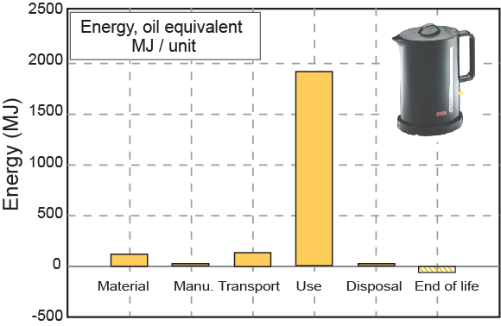
Eco audit: La bouilloire
Energie, Equivalent pétrole
MJ/unité
Energie (MJ)
Matériaux Fabrication Transport Utilisation Elimination Fin de vie
Qu’apprenons nous?
Gain minime pour un changement de matériaux
Gain important pour une isolation – parois doubles avec
mousse isolante ou mise sous vide
Ou, chauffer l’eau sur le moment et juste ce qui est nécessaire
Notes:
26
The frame shows the energy breakdown. The first two bars – materials (115 MJ) and manufacture (23 MJ) – are calculated from the data in the table by multiplying the embodied energy by the mass for each component, and summing. Air freight consumes 8.3 MJ/tonne.km, giving 135 MJ/kettle for the 12,000 km transport. The duty cycle (6 minutes per day, 300 days for 3 years) at full power consumes 180 kW.hr of electrical power. The corresponding consumption of fossil fuel and emission of CO₂ depends on the energy mix and conversion efficiency of the host country. The audit tool allows you to choose this.
The use-phase of life consumes far more energy than all the others put together. Despite using it for only 6 minutes per day, the electric power (or, rather, the oil equivalent of the electric power) accounts for 90% of the total. Improving eco-performance here has to focus on this use energy – even a large change, 50% reduction, say, in any of the others makes insignificant difference. Heat is lost through the kettle wall. Selecting a polymer with lower thermal conductivity or using an insulated double wall could help here – it would increase the embodied energy of the material bar, but even doubling this leaves it small. A full vacuum insulation would be the ultimate answer – the water not used when the kettle is boiled would then remain hot for long enough to be useful the next time it is needed. A more imaginative design option is to heat only the amount of water you are going to use, dispensing with the kettle itself and replacing it by a heated tube, with power only when water is running through it.
The seeming extravagance of air-freight accounts for only 6% of the total energy. Using sea freight instead increase the distance to 17,000 km but reduces the transport energy per kettle to a mere 0.2% of the total.
This dominance of the use-phase of energy (and of CO₂ emission) is characteristic of small electrically powered appliances.

Slide 27

L’éco-audit avancé dans l’édition Eco Design
Add record
Eco Audit
Synthesizer
Options….
Identique au model standard
?
^ 1. Material, manufacture and end of life
1 Composant 1 Fonte 30% 2.4 Coulée Usinage 10% Recyclé 95%
Joining and finishing
Usinage, polissage, % enlevé
% récupéré en fin de vie
Composant 1 Painture 0.55 m²
Composant 2 Soudage 0.7 m
?
Sélectionnez des procédés d’assemblage
(adhésifs, fixations, soudages)
et de finitions
(painture, enductions de surface, traitements thermiques et de surfaces)
Paramètres définis
v 2. Transport
?
Pour les enseignements plus poussés l’Outil Eco Audit Avancé est disponible dans les Editions Eco Design et Post-Bac EDD
(pour les Lycées) du CES EduPack.
v 3. Use
?
v 4. Report
Notes:
27
This frame introduces the enhanced CES Eco-audit Tool, available in the Eco Design Edition of CES EduPack.
The tool is opened from the Tools menu at the top of the CES EduPack screen. Its use involves the same four steps as the simple tool, listed as 1 to 4 in the frame. The differences are
The ability to include a machining process as well as a primary shaping process, choosing the fraction of the mass or volume that is removed by machining
The ability to specify not just the end-of-life choice but also the fraction of material recovered for each component.
The addition of one or more finishing processes for each component.
The addition of a joining process to assemble the product.

Slide 28
Et ensuite ?
CES possède deux ensembles d’outils aidant a explorer l’éco-conception dans la dimension des matériaux.
Outil 1. L’Eco-audits permet aux étudiants d’approximer et mettre en œuvre rapidement le “portrait” énergie / CO₂ des produits.
Outil 2. Les stratégies de sélections permettent de choisir de nouveaux matériaux afin de reconcevoir les produits et les faire répondre aux critères environnementaux, utilisant la méthode de sélection rationnelle des matériaux.
Ils permettent des audits rapides et une sélection rationnel des matériaux pour reconcevoir les produits.
Notes:
28
This final frame summarizes the points made in this Unit. More can be found in the textbook Materials and the Environment, and in the documentation of Granta’s CES Edupack. For more information, see www.grantadesign.com/education.

Slide 29
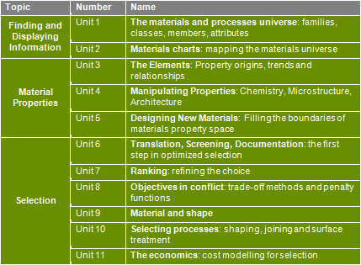
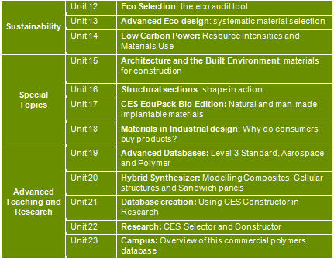

Différentes présentations
Ces PowerPoint de présentations sont disponibles sur le
site Web des Ressources d’Enseignement
Toutes les images de chacune des unités possèdent des notes explicatives (en anglais). Vous pouvez les visionner en ouvrant la présentation PowerPoint en vue Notes (View – Notes pages) ou en cliquant sur l’icône en bas de la barre d’outil de PowerPoint.
Notes:
Here you will find the notes
29

Slide 30

Aussi disponible pour le Développement Durable
Sur les sujets de:
Eco Design & Eco Audits
Low Carbon Power Systems
Exercices avec solutions détaillées
D’autres unités de cours
Papiers Blancs
Cas d’études interactifs
Enregistrement de Webinar
Posters
Fichier exemples pour les projets
Eco Audit
Liens vers d’autres ressources
Base de données Eco Indicator
http://teaching.grantadesign.com/open/eco.htm
Notes:
Resources are also available on other engineering, design and science topics.

Slide 31


Reproduction
Author
This work is licensed under a Creative Commons Attribution-NonCommercial-ShareAlike 3.0 Unported License.
Please make sure that Mike Ashby and Granta Design are credited on any reproductions. You cannot use this resource for any commercial purpose.
The Granta logo, the Teaching Resources logo and laptop image and the logo for the University of Cambridge are not covered by the creative commons license.
Professor Mike Ashby
University of Cambridge, Granta Design Ltd.
www.grantadesign.com/education
www.eng.cam.ac.uk
http://creativecommons.org/licenses/by-nc-sa/3.0/
Accuracy
We try hard to make sure these resources are of a high quality. If you have any suggestions for improvements, please contact us by email at teachingresources@grantadesign.com
M. F. Ashby, 2011
Granta’s Teaching Resources Website aims to support teaching of materials-related courses in Engineering, Science and Design.
The resources come in various formats and are primarily aimed at undergraduate students.
This resource is one of 23 lecture units created by Professor Mike Ashby.
The website also contains resources donated by faculty at the 800+ universities and colleges worldwide using
Granta’s CES EduPack.
The teaching resource website contains both resources that require the use of CES EduPack and those that don’t.
Some of the resources, like this one, are open access.
www.grantadesign.com/education/resources
Notes:
Granta is always interested in hearing about good teaching resources in the materials area. If you use something successfully with your students that you think we should link to from our web site, please get in touch. teachingresources@grantadesign.com
We continue to coordinate annual Materials Education Symposia. You can read about that here: http://www.grantadesign.com/symposium/index.htm

