Slide 1



Utilisation de CES Edupack
(Cambridge Engineering Selector)
4 Sélection d’un matériau 2/2

Slide 2
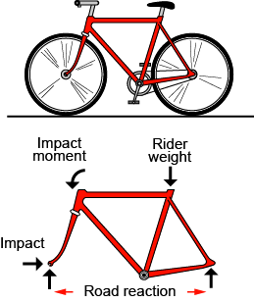
Analyse du cahier des charges
Exprimer les exigences de conception en termes de contraintes et d’objectifs
Cadre de vélo
Cahier des charges
Un label
Doit être
Suffisamment rigide
Résistant
Tenace
Peut être soudé
Fonction
Quelle est la fonction du composant ?
Contraintes
Quelles conditions essentielles doit-il respecter ?
Objectifs
Quel est le principal objectif ?
Minimiser
Coût
Poids
Volume
Impact éco.
Variables libres
Quelles sont les variables libres ?
Choix du
matériau
Notes:
This frame is a reminder of the step of translation, expressing design requirements in terms of function, constraints, objectives and free variables. An objective is a criterion by which the excellence of choice is to be judged. Thus the most desirable choice from among those materials that meet all the constraints might be the cheapest one – the objective is that of minimizing cost. It might be the lightest one – the objective is then that of minimizing mass. Other common objectives are those of minimizing volume and of minimizing the environmental impact associated with the choice.

Slide 3

Le boîtier de CD, avec un objectif
Traduction
Fonction
Boîtier de CD
Cahier des Charges
Contraintes
  1. Peut être moulé/injection
  2. Ténacité K_{1c} > celle du PS
  3. Clair
  4. Peut être recyclé
Contenir et protéger le CD mieux que le PS
Transparent
Moulable par injection
Recyclable
Aussi peu cher que possible
OBJECTIF
Minimiser le prix du matériau
Variable libre
Choix du matériau
Notes:
The translation step for the CD case, as in Unit 3. The design requirements on the left are re-expressed as constraints that the material must fulfil and objectives – criteria of excellence that will be use to rank the materials that meet the constraints. Here the objective is to minimize the material cost, provided all the constraints are met

Slide 4
Boîtier de CD : Sélection et classement
Sélection du niveau 2: Matériau
OBJECTIF
Minimiser le coût du matériau par boîtier C
1
Tree stage: moulage par injection
Volume du matériau pour le boîtier, V, fixé
Masse volumique ρ
Prix par unité de masse C_{m}
Coût du matériau/boîtier C = V C_{m} ρ
On les garde !
Polystyrène
2
Classement suivant cet indice
Ténacité
Matériaux restants
Polycarbonate
Propriétés Optiques
Transparence
Propriétés environnementales
Recyclable
X
X
Qualité Optique
Transparent
Translucide
Opaque
Polymères cellulosiques
3
Prix volumique C_{m} ρ
PMMA
2
3
1
Polystyrène
classement
Notes:
Screening and ranking for the CD case. The three screening steps on the left isolate (1) materials that can be injection molded (a “Tree” stage), (2) materials that are optically transparent and can be recycled (a Limit stage), and (3) materials that are tougher than polystyrene (a Graph stage). On the left, the objective of minimising the material cost per case is modelled, assuming that the volume V of material in the case is fixed. It leads to the index in the box. It is plotted in a further Graph stage, using the “Advanced” option to create the product (Material price per kg x Density). It allows the survivors of the screening stage to be ranked. The Results window (not shown here) lists the materials that meet oll the constraints and allows the survivors to be ranked by the value of the index.

Slide 5
Classement avancé : modélisation des performances
La méthode :
1. Identifier les fonction, contraintes, objectifs et variables libres
(lister les contraintes pour la sélection).
2. Écrire l’équation de l’objectif – “l’équation de performance”.
Si équation de performance inclue une variable libre (autre que le matériau):
Identifier la contrainte qui la limite.
L’utiliser pour éliminer la variable libre de l’équation de performance.
3. Isoler la combinaison de propriétés liées au matériau qui maximise la performance -- l’indice de performance
4. L’utiliser pour le classement
Notes:
This frame summarizes and extends the steps in using an objective for ranking. They are summarize under the headings 1, 2, 3 and 4 on this frame, omitting, initially, the red box in the middle.
Now for the extension – the red box. Sometimes the equation for the objective contains a free variable other than the choice of material – the next two frames give examples. If the volume V of material in the CD case of the last frame had not been defined as fixed, it would have been a free variable, one we could have varied to minimize the cost of the case. But changing V has other consequences, limited by other constraint such as a requirement for adequate stiffness. Then the constraint must be identified, setting a limit on V. Once that is established, the method continues as before.

Slide 6

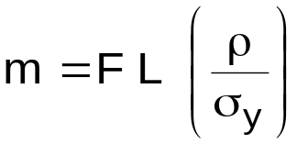
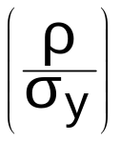

Exemple 1 : Barre légère et résistante
barre de longueur L et de masse minimum
Fonction
Barre
F
F
Aire A
L
Contraintes
Longueur L est spécifiée
Doit supporter une charge F
m = masse
A = aire
L = longueur
ρ = masse volumique
= résistance du matériau
Équation pour la contrainte en A:
F/A < σ_{y} (1)
Objectif
Minimiser la masse m:
m = A L ρ (2)
Variables libres
Choix du matériau
Aire de section A.
Éliminer A dans (2) grâce à (1):
Matériaux avec le plus petit rapport
Résultat
(ou maximiser )
Notes:
This and the next frame work through examples illustrating how to derive material indices when there is a free variable in addition to the choice of material; many more appear in later frames. Here we have the simplest of components – a tie rod. Its length L is defined. It must carry a prescribed tensile load F without failure (a constraint) and at the same time be as light a possible (an objective). The frame shows the steps, following the method of the last frame. Materials satisfying all the other constraints (such as operating temperature, corrosion resistance and so forth) and that have a low value of the index ρ/σ_{y} (or, equivalently, a high value of σ_{y}/ρ) are the best choice. If the constraint had been on stiffness rather than strength, the index becomes ρ/E (E is Young’s modulus).

Slide 7
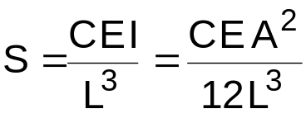
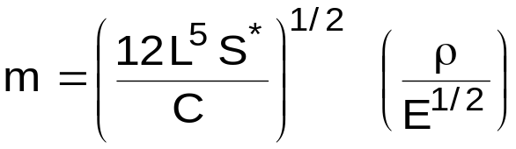
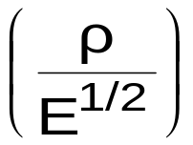
Exemple 2: Poutre légère et rigide
Fonction
Poutre
Poutre rigide de longueur L et de masse minimum
Aire de section
A = b²
b
L
Contraintes
La longueur L est fixe
Doit avoir une rigidité en flexion > S*
m = masse
A = aire
L = longueur
ρ = masse volumique
E = module de Young
I = moment d’inertie
(I = b⁴/12 = A²/12)
C = constante (ici, 48)
Équation pour la contrainte en rigidité :
(1)
Objectif
Minimiser la masse m:
m = A L ρ (2)
Variables libres
Choix du matériau
Aire de section A
Éliminer A dans (2) grâce à (1):
Choisir un matériau avec un petit rapport
Résultat
Notes:
The most usual mode of loading of engineering structures is bending: wing-spars of aircraft, ceiling and floor joists of buildings, golf club shafts, oars, skis, ….all these structures carry bending moments; they are beams. The requirement here is for a beam of specified stiffness and minimum mass. The frame lays out the steps, leading to the index ρ/E^{1/2} ; it differs from the index for a light stiff tie-rod because the mode of loading is bending, not tension. Later frames show how these indices are used to rank materials.
A panel is a flat sheet of given length and width: a table top, for instance. It differs from a beam in that the width of the beam is a free variable, whereas the width of the panel is prescribed. Otherwise the method, given in this frame, is the same. It leads to the index ρ/E^{1/3}.

Slide 8
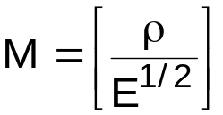
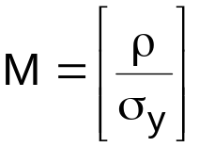
Les indices de performances
Fonction
Contrainte
Objectif
Variable libre
a un indice de performance
Chaque combinaison
FONCTION
Barre
Poutre
Arbre
Colonne
Mécanique,
Thermique,
Électrique...
CONTRAINTES
Minimiser ceci
Rigidité
Résistance
Fatigue
Géométrie
OBJECTIF
Coût minimum
Poids
minimum
Énergie stockée maximum
Impact environnemental minimum
INDICE
INDEX
Minimiser ceci
Notes:
Any combination of function, objective, constraint and free variable leads to a material index. The frame illustrates this, selecting the light stiff beam used in the previous frame. There are many such indices. They are listed in Appendix B of the Text “Materials Selection in Mechanical Design” and in Resource Book 2: Material Selection Charts.

Slide 9





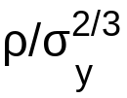
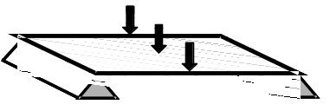


Démystifions les indices de performance
Un indice de performance est simplement une combinaison de propriétés qui apparait dans l’équation de performance (eg minimiser la masse ou le coût).
Parfois une simple propriété
Parfois une combinaison
L’un ou l’autre est un indice de performance
Contraintes
Traction (barre)
Flexion (poutre)
Flexion (panneau)
Exemple:
Objectif --
Minimiser la masse
Mesure de la performance = masse
Fonction Rigidité Résistance
(Ou maximiser
l’inverse)
Minimiser ceci !
Notes:
The material properties listed in handbooks – density, modulus and so on – are those that are measured to characterize the fundamental properties of materials – the physicists’ view of materials, one might say. The performance of an engineering component depends on the values of these, but, as the last three Frames showed, it usually depends not on one property but on a combination of two or more – it is these that we call material indices. They, too, are material properties; they are the ones that characterize engineering performance – the engineers’ view of materials, so to speak. The ones highlighted in this frame all depend on density ρ and modulus E. They are used in the frames that follow as examples for ranking.

Slide 10
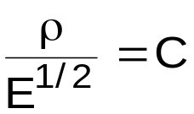
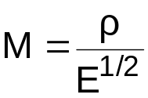

Sélection optimisée grâce aux graphes
Poutre légère et rigide :
1000
Indice
Ceramiq.
100
M décroissant
Réarrangement:
Composites
Bois
10
On passe en log:
Module d’Young E, (GPa)
Metals
Log E = 2 log ρ - 2 log M
1
Pente 2
2
Polymers
0.1
Le tracé de M donne
des lignes de pente 2
sur un graphe E-ρ
Foams
Elastomers
0.01
0.1
1
10
100
Masse Vol. (Mg/m³)
Notes:
We take the index M = ρ/E^{1/2} as an example (ρ is density and E is modulus). Rearranging and taking logs gives
Log(E) = 2Log(ρ) + 2 Log(M)
The schematic shows the chart used in Unit 2; its axes are Log(E) and Log(ρ). The equation describes a family of lines of slope 2, each corresponding to a value of M. One such line is shown. Materials above the line have lower values of M than those below it; the ones above are the best choice. By moving the line upwards the number of materials above it decreases, narrowing the list of those that maximize performance. The other indices involving E and ρ can be sown on the same chart. The index M = ρ/E appears as a line of slope 1; that for M = ρ/E^{1/3} as a line of slope 3. They are used in the same way.

Slide 11
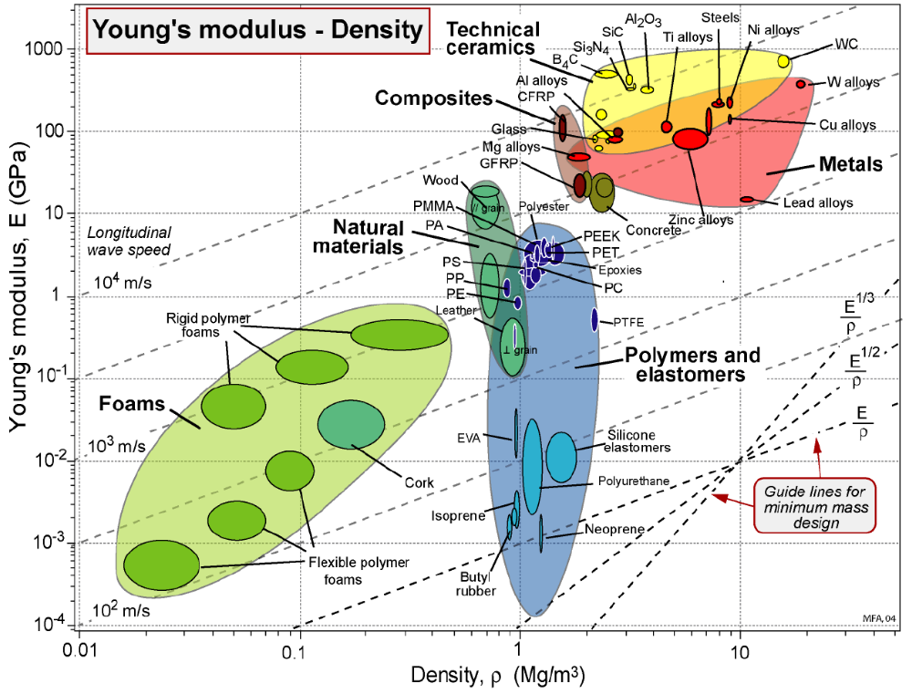

Sélection optimisée grâce aux graphes
Notes:
This frame show index-based selection on a property chart. The selection can be done using a hard copy chart, as illustrated here. The EduPack software gives greater flexibility, allowing the selection line to be moved and additional constraints to be applied. It lists, in the Results window, the materials that meet all the selection criteria, and makes records for them immediately accessible. The list can be ranke by the value of any property used as a constraint or by the value of the index.
Here it is interesting to point out to students an interesting fact brought out by the method. Many components of aircraft are stiffness-limited – the wing spar is an example – and the objective here is to minimize mass. Materials texts often assert that, for aerospace, material with high specific modulus E/ρ (low ρ/E , the way we have done things here) are the best choice when stiffness is important. But aluminum and steel have the same value of specific stiffness, and steel is much cheaper that aluminum – so why are wing spars not made of steel? The answer is that they are loaded in bending, and then the correct criterion of choice is not ρ/E but ρ/E^{1/2} . By that criterion aluminum is much better than steel, as the chart shows.

